Slide 1
cOmputer architecture
Basic Logic Gates
Ann Plummer

Slide 2
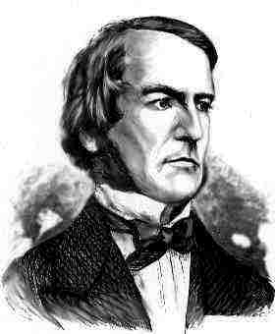
LOGIc gates
Objectives:
To understand the functions of logic gates.
2. To apply gained knowledge.
George Boole,
(1815-1864)
Did you know?
George Boole Inventor of the idea of logic gates. He was born in Lincoln, England and he was the son of a shoemaker in a low class family.
Notes:
About G. Boole:
http://www.google.co.uk/imgres?imgurl=http://library.thinkquest.org/C0126120/boole.jpg&imgrefurl=http://
http://www.kerryr.net/pioneers/boole.htm

Slide 3

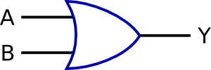


A logic gate is a digital circuit which either allows a signal to pass through it or to stop it.
There are seven basic logic gates: AND, OR, XOR, NOT, NAND, NOR, and XNOR.
AND
GATE
NOT
GATE
OR
GATE
?Logic !
Did you know?
Logic gates allow the computer to do things such as add, divide, multiply, do simple yes and no reasoning in certain situations along with other things.
Notes:
http://www.kpsec.freeuk.com/gates.htm
Note that logic gates are not always required because simple logic functions can be performed with switches or diodes:Switches in series (AND function)Switches in parallel (OR function)Combining IC outputs with diodes (OR function)

Slide 4
Input
An OR gate can have two or more inputs.
The output will be positive (True) if at least one input is true.
OR
GATE
Output
Input
ON/OFF
ON/OFF
FRONT DOORBELL
SWITCH
OR
GATE
DOORBELL
BACK DOORBELL
SWITCH
ON /OFF
Y = A OR B
Alternatives: Y = A + B Y = A v b
Notes:
The output is "true" if either or both of the inputs are "true." If both inputs are "false," then the output is "false.”
It is doesn’t matter if one input will be off- the output will be on
http://electronicsclub.info/gates.htm

Slide 5

Input
An AND gate can have two or more inputs.
The output will be positive (true) when both inputs (the input one AND the input two) are positive (true).
AND
GATE
Output
Input
ON/OFF
ON/OFF
PERSON SENSOR
AND
GATE
BURGLAR ALARM
c
ON SWITCH
FOR ALARM
ON /OFF
Y = A and B
Alternatives: Y = A . B Y = A ^ b y = ab
Notes:
The output is "true" when both inputs are "true.” Otherwise, the output is "false."
If one input will be off – the output will be off as well.
http://whatis.techtarget.com/definition/0,,sid9_gci213512,00.html

Slide 6

To add more sensors to alarm
BEDROOM
SENSOR
ON or OFF ?
OR
GATE
AND
GATE
FRONT ROOM
SENSOR
BURGLAR
ALARM
ON SWITCH
FOR ALARM

Slide 7



A NOT gate (inverter) has only one input.
It reverses the logic state.
Y = NOT A or
Y = A or Y = A’
NOT
GATE
Input
Output
ON
OFF
HEAT DETECTOR
(ABOVE 20 C)
NOT
GATE
CENTRAL
HEATING
OFF
ON
Notes:
NOT gate has only one input. It reverses the logic state.
If the input is on – the output will be off
If the input is off –the output will be on.

Slide 8
Is the Final Output ON (True)
or OFF (false) ?
ON
OR
GATE
OFF
AND
GATE
ON
FINAL
OUTPUT
ON ? OFF ?
AND
GATE
OFF
NOT
GATE

Slide 9

Going out decider:
Name the logic gates. Test it by answering True or false (Yes or No) for each Input. Try different inputs. Build it in your simulator and test it!
Got any money?
?
ON
YES,
Hitting town!
?
Friend has money?
?
?
Finished CAR work?
Suck it up. You’re staying in!
OFF
Big spot on nose?
?

Slide 10
Test 1:
1.
4.
ON
OFF
OFF
?
?
ON
ON
5.
2.
ON
?
OFF
?
ON
ON
OFF
6.
3.
ON
?
OFF
ON
?
The output is ON or OFF ?
OFF
OFF
Notes:
1- off, 2- on, 3-off, 4- on, 5-off, 6-on

Slide 11
Test 2:
7.
10.
OFF
?
ON
ON
OFF
OFF
8.
ON
ON
ON
?
?
ON
OFF
OFF
ON
9.
OFF
ON
ON
?
OFF
ON
ON
ON
ON
ON
The output is ON or OFF ?
Build some of the circuits from 1 to 10 in your simulator and test them
Notes:
7- on, 8-off, 9-off, 10- on

Slide 12
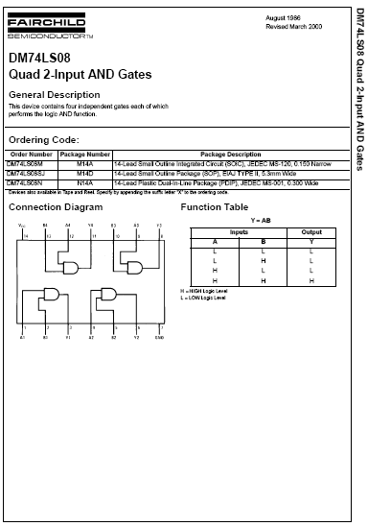
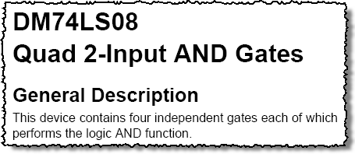
Where do these gates live? An example
Notes:
The General Description is found on the first page of a data sheet.
The first page of the data sheet will contain a general description of what the logic gate does, a connection diagram that shows how the gates are connected to the pins, and a function table the describes what the individual gates do in a in tabular form.

Slide 13
Integrated Circuits
Cutaway view of DIP (Dual-In-line Package) chip:
The TTL series, available as DIPs are popular for laboratory experiments with logic.

Slide 14
Integrated Circuits
DIP chips and surface mount chips
Pin 1
Dual in-line package Small outline IC (SOIC)

Slide 15
A
A
The AND Gate
X
X
B
B
The AND gate produces a HIGH output when all inputs are HIGH; otherwise, the output is LOW. For a 2-input gate, the truth table is
0 0
0 1
1 0
1 1
0
0
0
1
The AND operation is usually shown with a dot between the variables but it may be implied (no dot). Thus, the AND operation is written as X = A .B or X = AB It can also be written as X = A ^ B
Notes:
-AND can have more than two inputs. Draw truth table & Boolean expression for 3-input.

Slide 16
The OR Gate
A
X
A
X
B
B
The OR gate produces a HIGH output if any input is HIGH; if all inputs are LOW, the output is LOW. For a 2-input gate, the truth table is
0 0
0 1
1 0
1 1
0
1
1
1
The OR operation is shown with a plus sign (+) between the variables. OR operation is written as X = A + B.
It can also be written as X = A v B
Notes:
-OR can have more than two inputs. Draw truth table & Boolean expression for 3-input.

Slide 17
A
X
A
X
The NAND Gate
B
B
The NAND gate produces a LOW output when all inputs are HIGH; otherwise, the output is HIGH. For a 2-input gate, the truth table is
0 0
0 1
1 0
1 1
1
1
1
0
Notes:
-NAND can have more than two inputs. Draw truth table & Boolean expression for 3-input.

Slide 18
A
X
The NAND Gate
B
The NAND operation is shown with a dot between the variables and an overbar covering them. NAND operation is written as
X = A .B
Alternatively, X = AB
You can also use a single quote after the expression:
X = (A .B)’
Alternatively, X = (AB)’

Slide 19
The NOR Gate
A
X
B
Your turn!
Repeat exactly the same 2 pages, but describing a NOR gate

Slide 20

The XOR and XNOR Gates
Find out about these two …
What are their symbols?
What do the truth tables look like?
How would you describe their operation in English?
How would you write their functions?

Slide 21
Thanks to:
Tes.co.uk
Disneyaddictsguidetolife.com
http://www.kerryr.net/pioneers/boole.htm
Pearson Education

